Slide 1
FY16Q1 Happy Mooncake Customers Sub-Pillar Review – 2015-October
China CAT 2015/10/19

Slide 2
Agenda
Status – Consumptions & Happiness
Engagements – Capacity & Challenges
Executions – Alignment & Timeline
Program – Readiness & Campaign
Conclusion – Learnings & Moving Forward

Slide 3

STATUS

Slide 4
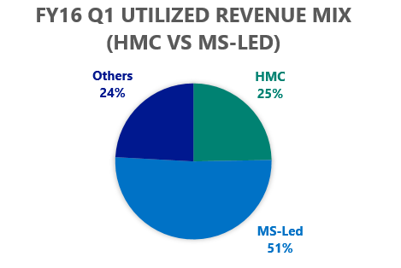
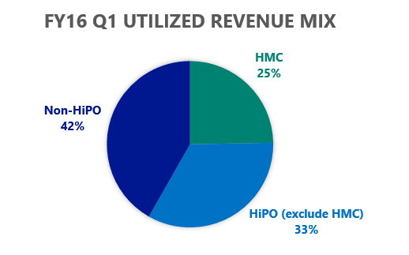
FY16 Q1 MC Utilized Revenue Mix
1
2
FY16 Q1 Utilized Revenue (USD)
FY16 Q1 Utilized Revenue (USD)
 | FY16 Q1
HMC | $2,513,303 | 25%
HiPO (exclude HMC) | $3,410,495 | 34%
Non-HiPO | $4,248,051 | 42%
 | $10,171,849
 | July | August | September | FY16 Q1
HMC | $735,652 | $906,214 | $871,437 | $2,513,303
MS-Led (exclude HMC) | $2,383,370 | $2,709,666 | $2,624,790 | $5,204,524
MS-Led Total | 344 | 354 | 374
Others |  |  |  | $2,454,023
 |  |  |  | $10,171,849

Slide 5
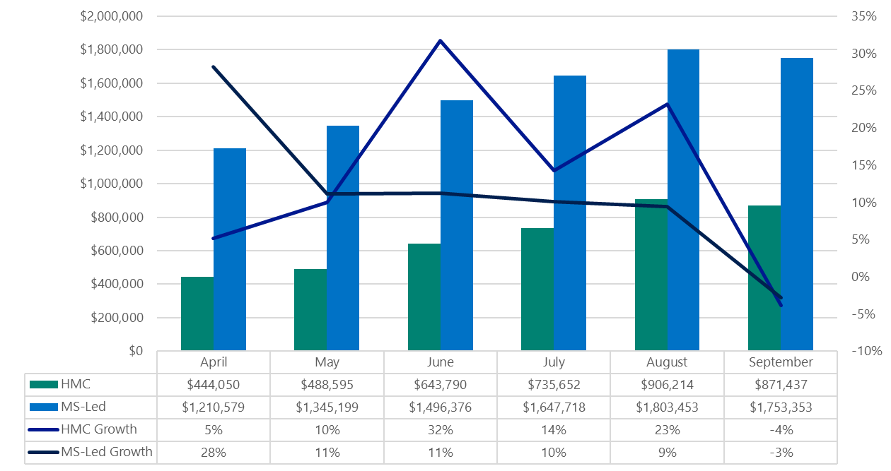
HMC Utilization Revenue Trend
1
2
HMCs Utilized Revenues of 2015 Apr. – Sept. (USD)
HMCs Total Committed vs Total Consumed (USD)
Committed
$8,372,698
Quarterly Growth Of 59%
1M
2M
3M
4M
5M
6M
7M
8M
9M
$1,256,463
FY15Q4
$1,576,435
FY16Q1
$2,513,302
$1,965,096
$7,311,296
(87.32%)
Consumed
Consumed
$1,576,434
$2,513,303
FY15 Q1
And Before
FY15
Q2 ~ Q3
FY15
Q4
FY16
Q1
3
HMCs Top Consumptions vs. Commitment (USD)
Customer Name | Total USD Commitment | Total USD Consumption | % of Total Consumption Vs. Commitment
chinaford(福特汽车(中国)有限公司) | $849,959 | $1,581,609 | 186.08%
qoros(观致汽车有限公司) | $277,598 | $466,766 | 168.14%
loreal(欧莱雅（中国）有限公司) | $104,930 | $162,959 | 155.30%
mengniu(内蒙古蒙牛乳业（集团）股份有限公司) | $554,646 | $786,413 | 141.79%
gmw(光明云（天津）科技有限公司（光明日报社 光明网迁移项目）) | $103,192 | $116,019 | 112.43%
coke(可口可乐饮料（上海）有限公司) | $592,635 | $576,145 | 97.22%
bestv(上海东方明珠新媒体股份有限公司) | $268,267 | $255,608 | 95.28%
samsung(北京三星通信技术研究有限公司) | $501,469 | $460,862 | 91.90%
honeywell(Honeywell (China) Co., Ltd) | $134,268 | $116,567 | 86.82%
pactera(文思海辉技术有限公司) | $903,188 | $757,120 | 83.83%

Slide 6
HMC Utilized Revenue At-A-Glance
1
3
7
6
5
4
2

Slide 7
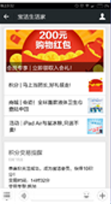
HMC Utilized Revenue At-A-Glance
1
Ford: (-10.91%)
For Ford, it is due to storage transaction utilization drop in around one week at Sep. Other workloads are healthy. The high consumption comes from the high transactions for testing, shouldn’t be view as sustainable. Effective October 1st, Ford will be charged a much lower rate for transactions.
chinaford | Storage Transactions | 2015-08 | 11136231 (10k)
chinaford | Storage Transactions | 2015-09 | 9424846 (10k)
2
Smartisan: (-46.70%)
Smartisan decided to use LRS instead GRS due to the cost pressure. So that consumption reduced by 46%
3
CNTV: (80.97%)
CNTV M2M consumption growth of 80.97% should be mainly caused by 36 additional VMs provisioned for 9/3 parade day. As we know, CNTV’s heavy load on 9/3 happened to hit the “weak” SLB (not dedicated VM) in Azure, which cause an incident of portal down.
4
P&G: (131.96%)
Consumption is up as P&G Wchat ecommerce system went live. (1) Host access layer for handling user inputs in WeChat with request and response pattern. Current production environment supports 博朗. Plan in future: Pampers – Oct, Nov – Olay, Jan 2016 – Oral B. (2) user click-stream and behavior telemetry into Azure storage for analytics user tagging in future. Current production environment supports 生活家，博朗，帮宝适商城
5
Marykay: (204.17%)
CDN for marketing and sales event. SQL Server on D-Series for the user analytics report. That’s why the cost is high.
6
McDonald: (27.98%)
Migrate A-Series VM to D-Series for voucher campaign.
7
HTC: (-23.66%)
HTC Studio Project test finished, all related VM are shutdown.

Slide 8
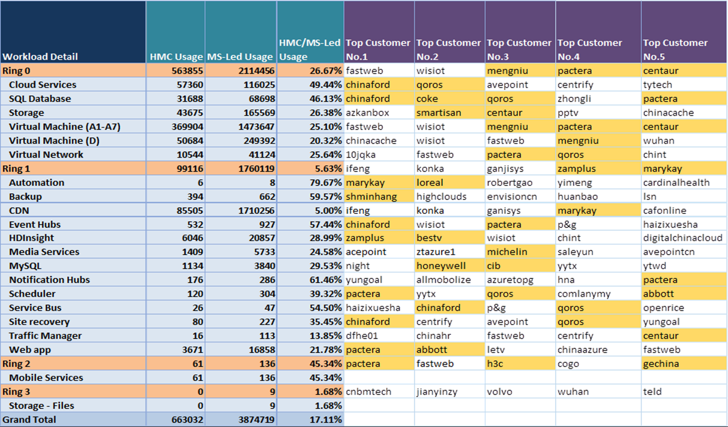
Workload Usages At-A-Glance
There are some errors to the numbers due to overage.

Slide 9
Happiness KPIs
1
High-Availability - Awareness & Key Solutions
3
KPIs | MS-LED | HMC | Trend
# of customers with AS | 148/392 (38%) | 23/30 (77%)
# of VMs with AS | 1787/8024 (22%) | 439/1404 (31%)
# of customers with GRS | 293/375 (78%) | 23/25 (92%)
# of customers with Traffic Manager | 24/375 (6%) | 4/25 (16%)
# of customers with Secondary Geo DB | 5/375 (1%) | 1/25 (4%)
# of customers with HA Redis Cache | 14/375 (4%) | 2/25 (8%)
# of customers with Storage Stripping | 0/375 (0%) | 10/25 (40%)
# of Key Solutions in HMCs with DR | - - | 4/30 (13%)
# of Key Solutions in HMCs with HA | - - | 26/30 (87%)
2
References - Best Practices w/ High Level Services
4
KPIs | Nominations | Estimate Complete | Status
Best Practices for Digital Marketing | McDonalds
Best Practices for IoT | Qoros / Honeywell
Best Practices for IT Transformations | TBD
Best Practices for Mobile Solutions | XiaoMi
Best Practices for Business Transformations | Yongyu
The data of High-Availability features is from EA Portal, counting based on number of customers that have paid for the HA features.
# of VMs with AS does not count an AS with only one VM.
High-Availability KPIs' trend will provide in next month review.
Reference KPIs' Estimate Complete and Status will provide in next month review
True-Up - ticket metrics are not ready due to integration in progress of 21v incidents DB to C360
True-Up - rating metrics are not ready due to Premier deployment still in progress.
True-Up - Healthy Consumptions & Satisfactions
KPIs | HMC | Trend | Status
Total monthly utilized revenue (2015-Sept) | $871,543 | MoM (-8.34%) | 2015-Aug = $906,214
HMCs in DE | 8
# of Total Active Tickets
# of Total Ticket Age > 7D
Average Support Rating (Last)
Average Workload Rating (Last)
5
6

Slide 10
Happiness KPIs (76% )
Customer Name | Happiness
abbott(雅培贸易(上海)有限公司)
bestv(上海东方明珠新媒体股份有限公司)
centaur(北京易店宝科技发展有限公司)
chanjet(畅捷通信息技术股份有限公司)
chinaford(福特汽车(中国)有限公司)
cib(上海南洋万邦软件技术有限公司（兴业银行__ 微软公有云Azure服务项目）)
cntv(神州数码系统集成服务有限公司)
coke(可口可乐饮料（上海）有限公司)
gechina(通用电气（中国）有限公司)
gmw(光明云（天津）科技有限公司（光明日报社 光明网迁移项目）)
h3c(杭州华三通信技术有限公司)
haier(山东青鸟软通信息技术股份有限公司（海尔集团国内公有云项目）)
hisense(青岛海信传媒网络技术有限公司)
honeywell(Honeywell (China) Co., Ltd)
htc(宏达通讯有限公司)
iresearch(上海艾瑞市场咨询有限公司)
loreal(欧莱雅（中国）有限公司)
macdonald(麦当劳（中国）有限公司)
marykay(玫琳凯（中国）化妆品有限公司)
mengniu(内蒙古蒙牛乳业（集团）股份有限公司)
michelin(米其林（中国）投资有限公司)
p&g(欧唯特信息系统(上海)有限公司(宝洁(中国)有限公司 生活家项目))
pactera(文思海辉技术有限公司)
qoros(观致汽车有限公司)
samsung(北京三星通信技术研究有限公司)
shminhang(上海市闵行区科学技术委员会)
smartisan(锤子科技（北京）有限公司)
yonyou(用友网络科技股份有限公司)
youzu(上海游族信息技术有限公司)
zamplus(上海晶赞科技发展有限公司)
Bodhiworld
Lenovo
Xiaomi
Centaur – Joy Qiao
(1) Impacts on recent ToR upgrade that requires Centaur customers to stop accessing their ERP in night time. (2) Impacts on recent outage of SHA03 causes their larges customer (Meizu) not able to access their ERP for 24+ hours due to XIO
China Ford – David Liu
(1) Service Bus throttling issue due to SQL Azure upgrade. (2) Service Bus timeout issue, recommend of implementing retry logic but without RCA
Coke (7/7) – Yiyu Liu
(1) outages of the 21Vianet Azure were frequent including Azure SQL Database/Webrole can’t connect to SQL Azure, websites can’t be opened, VM can’t be visited. (2) not satisfied because the responsive is not so fast and sometimes is pending for Microsoft to take next actions (3) RCA take so long
Mengniu – Shirley Wang
(1) Highly impacted by ToR update and planned maintenances.
Qoros (7/5) – David Liu
(1) Key component had problem several times in June. 6/12 ServiceBus outage, 6/29 ServiceBus can’t access, 5/27-6/3 A VM reboot 6 times in 6 days (2) Support can't find or explain the root cause of the failures. No workaround provide either.
Xiaomi – Wei Sun (1) Storage latencies of blob writes when using CentOS/Java 300ms vs 150ms in other cloud platform. (2) I/O Wait up to 8 secs. when using CentOS (spontaneously)

Slide 11
ENGAGEMENTS

Slide 12
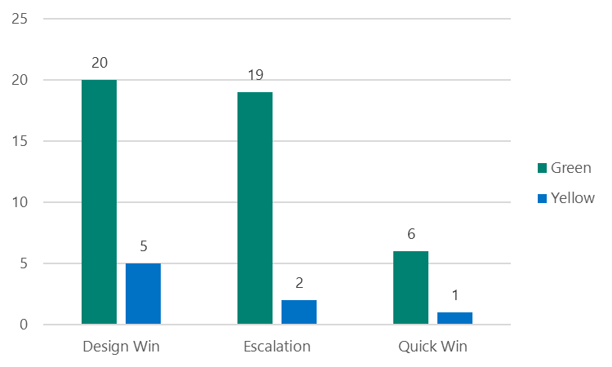
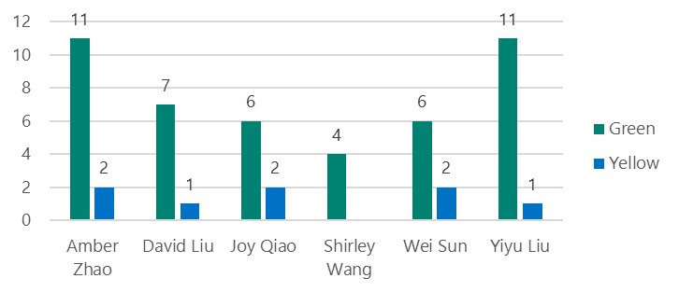
Current CAT Engagements
1
53 active engagements
Engagements by Types
Design Win (3~6 months) / Quick Wins (~3 months) / Escalations (On-Demand)
Total 53 (40+ for HMCs) active customer engagements against 32 customers (25 HMC + 8 upsides); 12 engagements are from upsides
88% engagement capacity
2
Engagements by PM
With each PMs capacity of 6 concurrent engagements, a total of 60 engagements (with 10 PMs fully hired) concurrent at a time. Each PM will owns 3 customers with 6 concurrent engagements.
There're field escalations submitted (through http://catrequests) which are pending for approval due to tight bandwidth

Slide 13
Current CAT Engagements
Prospect
Engage
Best Practices for
Digital Marketing
Best Practices for
IT Transformation
Best Practices for
IoT
Best Practices for
Mobile Solution
Best Practices for Business Transformation

Slide 14
Challenges & Opportunities
CAUSES: Services Quality
Customer Name | Key Challenge/ask | Opportunity
chinaford(福特汽车(中国)有限公司) | Service Bus timeout with failure of DB connection
Cib (上海南洋万邦软件技术有限公司（兴业银行__ 微软公有云Azure服务项目）) | Poor MySQL PaaS OLTP performance (insert/update) and CPU overloading | MySQL PaaS adoption for P2P service Redis cache adoption for mobility services
cntv(中国中央电视台) | Platform stability (vm reboot, SLB, mgmt portal down) | Industry leading media cloud strategy, plan
Coke (可口可乐饮料（上海）有限公司) | AWS compete for SAP system on Coke BIG (Bottler Investment Group) | Redis cache, MySQL PaaS, Media service and Storsimple adoption/migration
honeywell(Honeywell (China) Co., Ltd) | VM reboot (10 VMs were rebooted in AirTouch production around 9/14 2:30 to 9/14 3:00) | Smart building with AML
mengniu(内蒙古蒙牛乳业（集团）股份有限公司) | All single instance VMs without using HAS due to dev/test cost of re-architecting app
michelinac(米其林（中国）投资有限公司) | All single instance VMs without using HAS
p&g (欧唯特信息系统（上海）有限公司（宝洁（中国）有限公司 生活家项目）) | DNS issue on Cloud Service (i.e. During 9/19 to 9/22) Issue was mitigated, but without RCA
Xiaomi | MFA, CNNIC certificate, performance, ER | IOT, Project Oxford – Face API, “warm” data

Slide 15
Challenges & Opportunities
CAUSES: Services/Feature Symmetry
Customer Name | Key Challenge/ask | Opportunity
abbottcn(雅培贸易(上海)有限公司) | Poor built-in SQL DB devops experience is a blocker due to delay of lbiza portal. PowerShell is not user friendly. | Core CRM system SQL DB PaaS migration
Coke (可口可乐饮料（上海）有限公司) | AWS compete for SAP system on Coke BIG (Bottler Investment Group) | Redis cache, MySQL PaaS, Media service and Storsimple adoption/migration
h3c(杭州华三通信技术有限公司) | Demanding on virtual Network: IP Forwarding, App Gateway: SSL Offload Aliyun, Tencent cloud pricing compete | Wi-Fi device IOT service with Azure IOT suite (event hub, HDI, machine learning, storage)
hisense(青岛海信传媒网络技术有限公司) | Oracle DW migration to HDI Lacking of services such as Azure Machine Learning, Azure DocumentDB, Azure HDInsight(Linux based), Azure Data Factory, PowerBI. | Smart device, smart homw
loreal(欧莱雅（中国）有限公司) | SH ER dependency | Websites, SQL DB migration, Project Oxford – Face API
marykay(玫琳凯（中国）化妆品有限公司) | Need verified Barracuda Firewall, SH ER support for virtual appliance Need RBAC (VM, Cloud Services, HDI) | HDI, Project Oxford – Face API
Xiaomi | MFA, CNNIC certificate, performance, ER | IOT, Project Oxford – Face API, “warm” data

Slide 16
Challenges & Opportunities
CAUSES: New Features Request
Customer Name | Key Challenge/ask | Opportunity
centaur(北京圣特尔科技发展有限公司) | All single instance VMs without using HAS due to cost concern 3-part DB name support for SQL DB | SQL DB/Malmo migration
Gmw (光明云 （天津） 科技有限公司 （光明日报社 光明网迁移项目）) | Media service player support for broader devices (i.e. Android 4.3 and lower versions) | Cloud service, MySQL PaaS and HDI PaaS adoption/migration for “云端读报” (Newspaper reading in cloud), social sentiment analysis system (舆情分析系统)
iresearch(上海艾瑞市场咨询有限公司) | SQL compatibility due to lacking of SQL DB features (cross DB read & write, Agent job, UTC+8 timezone) | Websites and SQLDB migration
yonyoucloud(用友网络科技股份有限公司) | AliYun pricing compete Lacking of 3-part DB name, EXTERNAL_ACCESS or UNSAFE CLR assembly support for SQL DB
youzu(上海游族信息技术有限公司) | Need scheduled Azure maintenance support (RMN)
zamplus(晶赞广告（上海）有限公司) | Need local time zone (than UTC) support for HDI | DMP onboarding (25 to 150 Node, 500GB data everyday); AML adoption

Slide 17
Challenges & Opportunities
CAUSES: Other
Customer Name | Key Challenge/ask | Opportunity
gechina(通用电气（中国）有限公司)
htc(宏达通讯有限公司) | China Education Network to add China Telecom Azure IP range | Notification hub adoption for SMS server
macdonald(麦当劳（中国）有限公司) |  | Websites, MySQL PaaS, mobile service adoption
qoros(观致汽车有限公司) |  | QCloud vNext with Azure IOT suite
samsung(北京三星通信技术研究有限公司) |  | CDN, Samsung Pay and Samsung EMS

Slide 18
EXECUTIONS

Slide 19
Priority
Organization: Hiring
Full hiring of additional 4 PMs and 3 Engineers by end of Q3
Total of 10 PMs, 5 Engineers and 3 overheads
Engagements: HiPO / CAT Alignment & RoB
Joined Kick-Off with HiPO team to align R&R and working rythums
Joined China Sales Readiness Roadshow in Q2
Regular RoB Review with HiPO team
Services: Premier / CAT Alignment & RoB
Deploy Premier to first 4 HMC by Q2
Complete all Premier deployment to rest of HMC by Q3
Support: CSS&21v / CAT Alignment & RoB
Optimize workflow and communication flow with CSS and 21v
Regular RoB Review with CSS & 21v

Slide 20
China CAT Working Model
Engineering Impacts Insights
Design and Quick Marquee
Wins Wins
High-Availability
Awareness & Key Solutions
References
Best Practices w/ High Level Services
True-Up
Healthy Consumptions & Satisfactions
25
HMCs
Services Symmetry
CAT PMs
CAT Engineers
Escalations Engineering
or On-Demand Patterns/Practices
Field & Strategic Partners Readiness

Slide 21
Timeline
Mark Souza
Shawn Rice / Rohan Kumar
Mark Ozur
TBD
TBD
TBD
Aisa cat
summit
CI Replay
catA/H
CAT WW Meeting
TR22
CNY Holidays
Premier/CAT Alignment
Hipo/cat
rob
Premier/CAT rob
Hipo/cat
rob
Premier/CAT rob
Hipo/cat
rob
Premier/CAT rob
Premier/CAT rob
Hipo/cat
rob
Premier/CAT rob
Premier deployment
on top 4
Premier deployment
On rest of HMC
CSS/21v alignment & rob
Hipo/cat offsite
Smsg
readiness
PREMIER ATTACH
AZURE BUSINESS CONTINUITY
CAT AZURE ADVISORS
AzureCAT #Chlorine Phase#1
AzureCAT #Chlorine Phase#2
AzureCAT #Chlorine Phase#3
Oct.
Nov.
Dec.
Jan.
Feb.
Mar.
Apr.

Slide 22
PROGRAM

Slide 23
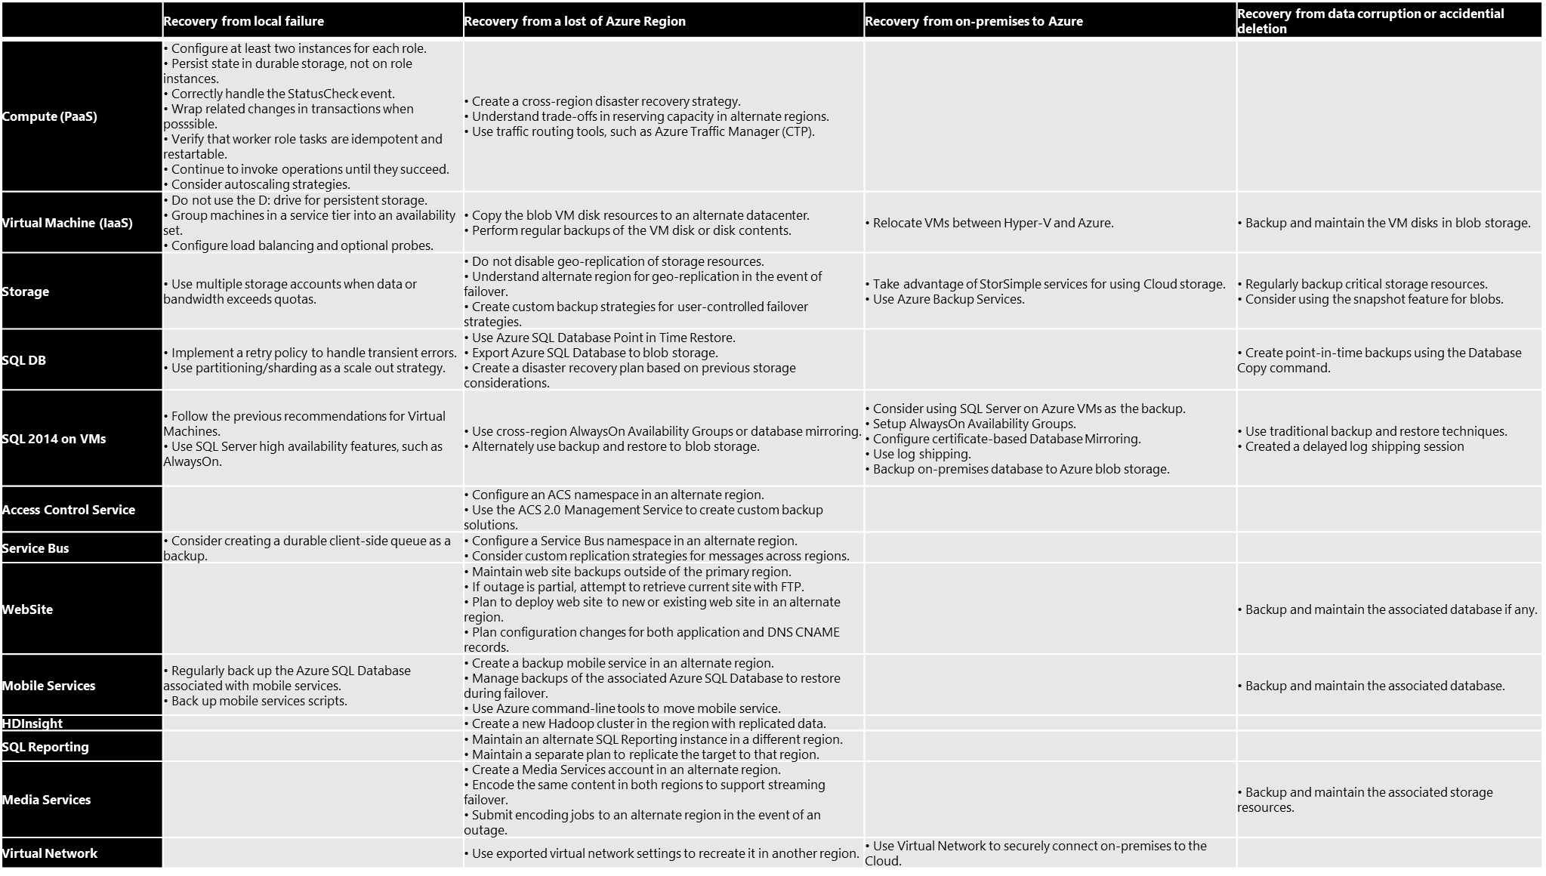
Azure Business Continuity
Align with HiPO team’s Mooncake Maturity Model
Apply check-lists to each critical project(s) sign-off
Core part of Field Readiness
Continue to evolve by CAT through learnings and feature symmetry
https://msdn.microsoft.com/library/azure/hh873027.aspx
https://msdn.microsoft.com/library/azure/jj717232.aspx
https://msdn.microsoft.com/library/azure/jj853352.aspx
https://msdn.microsoft.com/en-us/library/azure/dn251004.aspx

Slide 24
 | Recovery from local failure | Recovery from a lost of Azure Region | Recovery from on-premises to Azure | Recovery from data corruption or accidential deletion
Compute (PaaS) | • Configure at least two instances for each role. • Persist state in durable storage, not on role instances. • Correctly handle the StatusCheck event. • Wrap related changes in transactions when posssible. • Verify that worker role tasks are idempotent and restartable. • Continue to invoke operations until they succeed. • Consider autoscaling strategies. | • Create a cross-region disaster recovery strategy. • Understand trade-offs in reserving capacity in alternate regions. • Use traffic routing tools, such as Azure Traffic Manager (CTP).
Virtual Machine (IaaS) | • Do not use the D: drive for persistent storage. • Group machines in a service tier into an availability set. • Configure load balancing and optional probes. | • Copy the blob VM disk resources to an alternate datacenter. • Perform regular backups of the VM disk or disk contents. | • Relocate VMs between Hyper-V and Azure. | • Backup and maintain the VM disks in blob storage.
Storage | • Use multiple storage accounts when data or bandwidth exceeds quotas. | • Do not disable geo-replication of storage resources. • Understand alternate region for geo-replication in the event of failover. • Create custom backup strategies for user-controlled failover strategies. | • Take advantage of StorSimple services for using Cloud storage. • Use Azure Backup Services. | • Regularly backup critical storage resources. • Consider using the snapshot feature for blobs.
SQL DB | • Implement a retry policy to handle transient errors. • Use partitioning/sharding as a scale out strategy. | • Use Azure SQL Database Point in Time Restore. • Export Azure SQL Database to blob storage. • Create a disaster recovery plan based on previous storage considerations. |  | • Create point-in-time backups using the Database Copy command.
SQL 2014 on VMs | • Follow the previous recommendations for Virtual Machines. • Use SQL Server high availability features, such as AlwaysOn. | • Use cross-region AlwaysOn Availability Groups or database mirroring. • Alternately use backup and restore to blob storage. | • Consider using SQL Server on Azure VMs as the backup. • Setup AlwaysOn Availability Groups. • Configure certificate-based Database Mirroring. • Use log shipping. • Backup on-premises database to Azure blob storage. | • Use traditional backup and restore techniques. • Created a delayed log shipping session
Access Control Service |  | • Configure an ACS namespace in an alternate region. • Use the ACS 2.0 Management Service to create custom backup solutions.
Service Bus | • Consider creating a durable client-side queue as a backup. | • Configure a Service Bus namespace in an alternate region. • Consider custom replication strategies for messages across regions.
WebSite |  | • Maintain web site backups outside of the primary region. • If outage is partial, attempt to retrieve current site with FTP. • Plan to deploy web site to new or existing web site in an alternate region. • Plan configuration changes for both application and DNS CNAME records. |  | • Backup and maintain the associated database if any.
Mobile Services | • Regularly back up the Azure SQL Database associated with mobile services. • Back up mobile services scripts. | • Create a backup mobile service in an alternate region. • Manage backups of the associated Azure SQL Database to restore during failover. • Use Azure command-line tools to move mobile service. |  | • Backup and maintain the associated database.
HDInsight |  | • Create a new Hadoop cluster in the region with replicated data.
SQL Reporting |  | • Maintain an alternate SQL Reporting instance in a different region. • Maintain a separate plan to replicate the target to that region.
Media Services |  | • Create a Media Services account in an alternate region. • Encode the same content in both regions to support streaming failover. • Submit encoding jobs to an alternate region in the event of an outage. |  | • Backup and maintain the associated storage resources.
Virtual Network |  | • Use exported virtual network settings to recreate it in another region. | • Use Virtual Network to securely connect on-premises to the Cloud.

Slide 25
CAT Azure Advisors
Groups
Azure Advisors
ALM Advisors
ALM Partner Leaders
API Management Advisors
App Service Advisors
Azure Machine Learning Advisors
Azure Search Advisors
Azure Storage Advisors
Azure Scheduler Advisors
Azure SQL Data Warehouse
BI Advisors
Big Compute Advisors
Big Data Advisors
BizTalk Advisors
Dev/Test Lab Advisors
Developer Advisors
Identity Advisors
Java Advisors
Linux and OSS Advisors
Marketplace Advisors
Mobile Advisors
Network Advisors
NoSQL Advisors
Oracle Advisors
Orleans Advisors
Premium Storage Advisors
Portal Advisors
PowerShell Advisors
Resource Manager Advisors
SAP Advisors
Service Bus Advisors
SQL Database Advisors (Azure Advisors)
SQL Server Advisors (Data Platform Advisors)
Systems Integrator Advisors
Virtual Machine Advisors
Azure Advisors is a private, invitation-only group for organizations who desire a closer connection with the Microsoft Azure engineering team. Azure Advisors is a technical group designed to facilitate the exchange of feedback, ideas and best practices between engineering teams. It is not used for sales and marketing or free technical support.
WW Advisor Program in Q1 continued enrollment growth for a total of 1620 organizations from 77 countries who desire a closer connection with Azure and C&E engineering. Each enrolled organization has a signed NDA & Input Agreement/Feedback clause, and can be engaged directly by engineering for general feedback and validation. Azure Advisor includes:
71% Partners/Solution Builders of which 41% are Systems Integrators, and 59% are ISVs
24% Customers. of which 66% are Enterprise, 23% Small/Mid, 6% Education, 6% Government
3% identify as an Individual including MVPs, Trainers, and Authors
2% identify as Solution Hosters including Managed Enterprise Hosters, Telco, Web Hoster, and OEMs

Slide 26
CONCLUSION

Slide 27
Learnings
Focus on customers’ needs – rather than what they want.
Learn from ROW – their challenges and practices
Work as a team – stronger alignment with HiPO, CSS, Premier, and 21v
Feedbacks to component team – with customers’ scenarios and competitions

Slide 28
Moving Forward
HMC Accounts re-alignment with HiPO team
25 Happy Mooncake Customers vs. 0 Un-Happy Mooncake Customers
Azure Pulse Executives Sponsors

Slide 29
© 2013 Microsoft Corporation. All rights reserved. Microsoft, Windows, Windows Vista and other product names are or may be registered trademarks and/or trademarks in the U.S. and/or other countries.
The information herein is for informational purposes only and represents the current view of Microsoft Corporation as of the date of this presentation. Because Microsoft must respond to changing market conditions, it should not be interpreted to be a commitment on the part of Microsoft, and Microsoft cannot guarantee the accuracy of any information provided after the date of this presentation. MICROSOFT MAKES NO WARRANTIES, EXPRESS, IMPLIED OR STATUTORY, AS TO THE INFORMATION IN THIS PRESENTATION.

Slide 30
FY16 Q1 MC Utilized Revenue Mix
FY16 Q1
Mix (USD)
FY16 Budget
Mix
$2,513,302
HMCs
25
HMCs are contributing 73% of total HiPO Utilized Revenue
60%
$3,410,496
HiPOs
114
(44 EPG/20 PSG/50 CA)
MAL
Penetrations
487
(137 EPG/67 PSG/283 CA)
30%
$4,248,051
10%
Web Direct
Total: $10,171,849

